Slide 1
Malaria Parasite Detection Using Blood Smears
IE 7615 : Neural Networks / Deep Learning
Nayan Patel
Yusuf Feroze
Nikilesh Kumar

Slide 2
Motivation
Malaria is a serious disease that is spread by mosquitoes.In 2016, over 216 million cases of malaria was reported around the world and mostly in developing nations.
Diagnosis of malaria is done by inspecting blood smear slides and finding out if the sample has the markers of infection. This is usually done by parasitologists
Much research has been done to automate and standardize the detection process. In our project we present a solution that involves using a CNN framework to classify infected vs. non-infected cells.

Slide 3
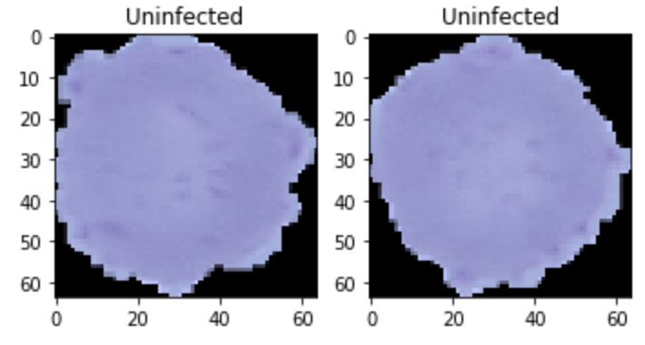
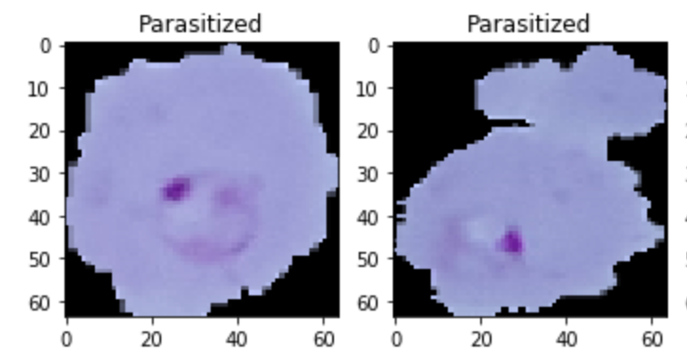
Our Dataset (Data Collection and Preprocessing)
Our dataset consist of 27588 image slides of infected and non-infected cells (equal instances of each) captured as smear slides from patients at the Chittagong Medical College Hospital, Bangladesh. Each slide was manually annotated by parasitologists at Mahidol-Oxford Tropical Medicine Research Unit in Bangkok, Thailand.
This dataset was hosted at the US National laboratory for medicine
The images were resized to 64 x 64 x 3 and the labels were converted using one-hot encoding as part of pre-processing.

Slide 4
Data Augmentation Techniques Experimented
Histogram Equalization - This technique increases the contrast values between pixels in the image by applying a normalization probability function on the histogram of pixel values generated.
Affine Augmentation methods (Rotations, Pixel Shifts)
ZCA Whitening - A whitening technique that works by dividing principal components by the square root of PCA eigenvalues

Slide 5
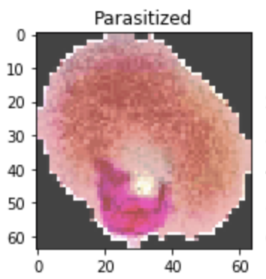
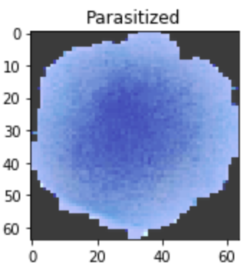
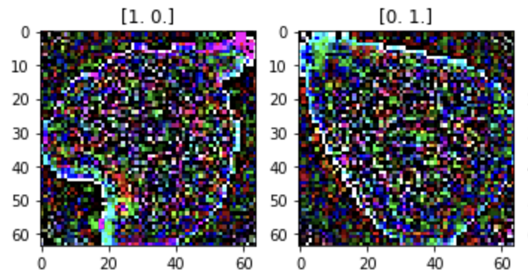
Data Augmentation Techniques Experimented
Histogram Equalization
Affine Augmentation methods (Rotations, Pixel Shifts)
ZCA Whitening - A whitening technique that works by dividing principal components by the square root of PCA eigenvalues

Slide 6
Neural Network Architectures
We use CNN for our Neural Networks. We present two different architectures here
Model Architecture 1
1 - Conv-Pool-Conv
3 convolutional layers
3 pooling layers
3 dropout layers.
ReLU activation for input and hidden layers
SoftMax function was used at the output layer.
Max pooling and batch normalization
Stride =1
3x3 kernel
‘ADAM’ optimizer
Learning Rate = 0.001 & Decay rate =0.001/batch size
Mini-batch size = 64.

Slide 7
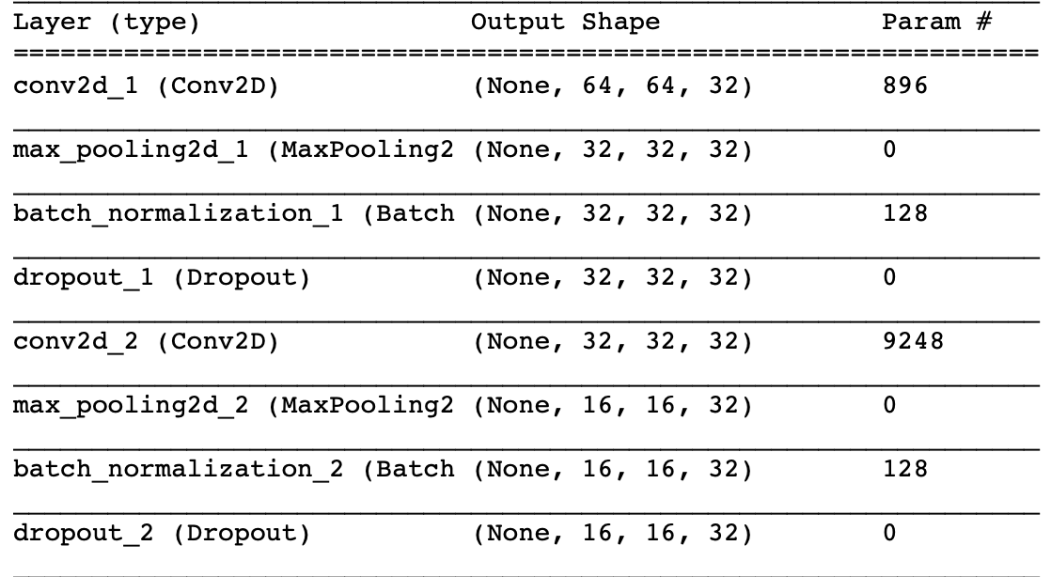
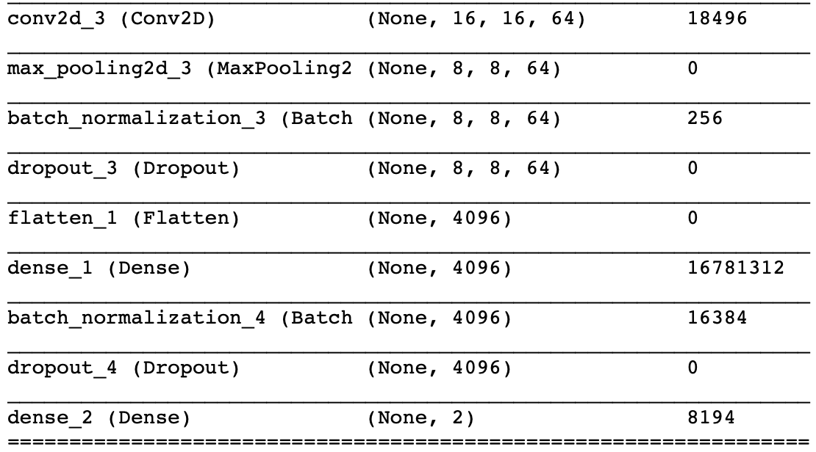
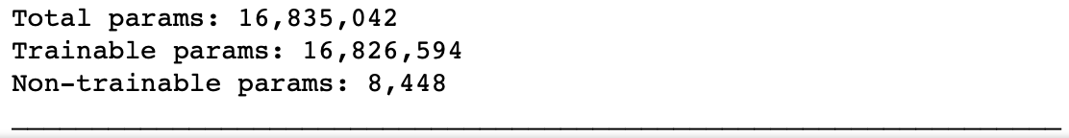
Neural Network Architectures
Model Architecture 1

Slide 8
Neural Network Architectures
We use CNN for our Neural Networks. We present two different architectures here
Model Architecture 2
Conv-Conv-Pool
4 convolutional layers
2 pooling layers
2 dropout layers.
ReLU activation for input and hidden layers
Sigmoid function was used at the output layer.
Max pooling and batch normalization
Stride =2
3x3 kernel
SGD optimizer
Learning Rate = 0.01 & Decay rate =0.001/batch size
Mini-batch size = 64.

Slide 9
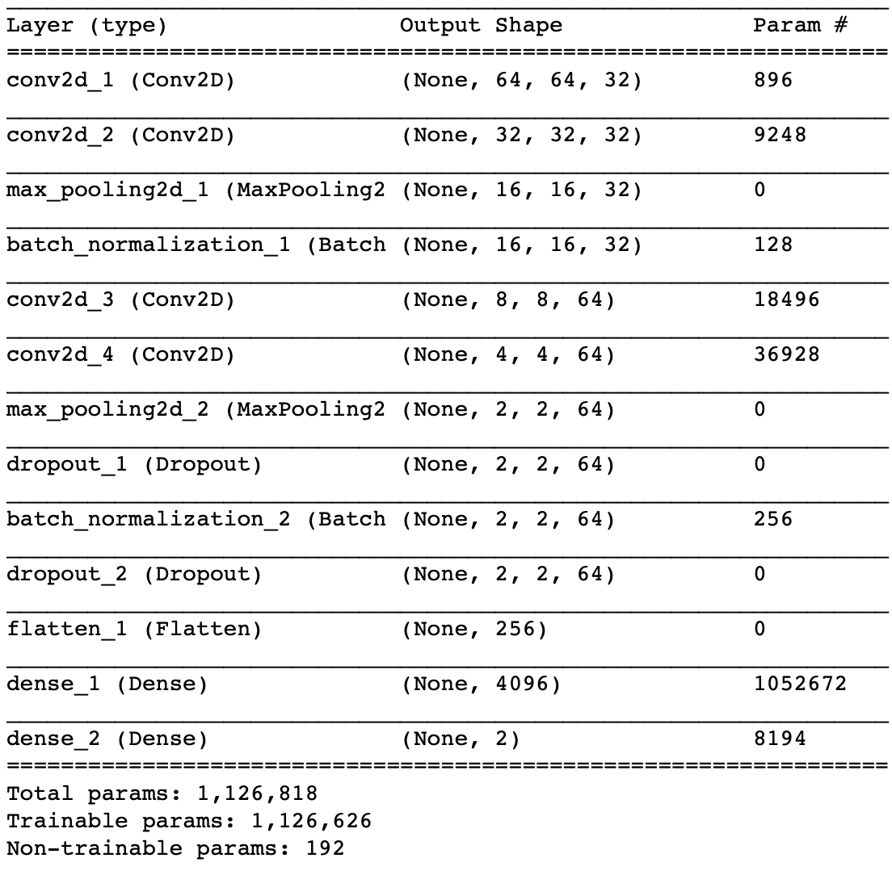
Neural Network Architectures
Model Architecture 2

Slide 10
Hyperparameter Tuning Experiments
Following experiments were made to improve the performance of the models:
Batch Size and Size of Training Data
Learning Rate and Decay
Optimizer Used (SGD, Adam)
Momentum (0-1)
Number of dropouts, dropout rate
Strides (1,2)
Kernel Dimensions ((1,1) (3,3))
Activation Functions (Sigmoid, Softmax)

Slide 11
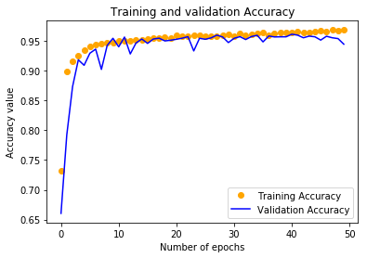
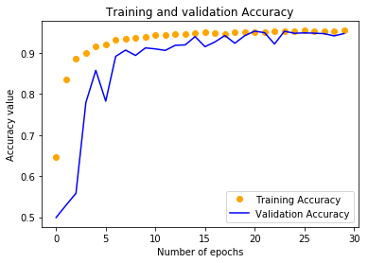
Experiment:
Training Data Size
We decided to implement image augmentation to increase the size of our training data and induce more robustness to our classification model.
Pixel shifts and Rotations to increase our training data size from 17636 to 35272 images.
Training accuracy increases slightly but validation accuracy remained the same.
35272 Training Samples
17636 Training Samples

Slide 12
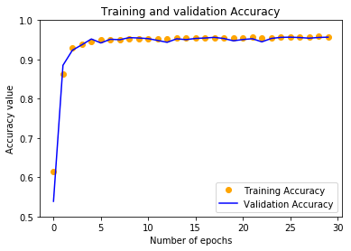
Experiment: Comparing 2 Architectures
Model-I Conv-Pool-Conv model was compared against Model-II, the Con-Conv-Pool stacked architecture model
Training and Validation gave much quicker and consistent results in Model-II
Conv-Pool-Conv
Conv-Conv-Pool

Slide 13
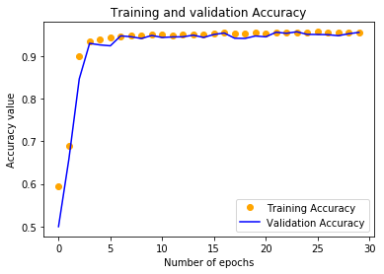
Selected Model After Tuning Hyperparameters
We utilized the following hyperparameters for our final model
Batch Size (64) and Size of Training Data (17636)
Learning Rate (0.01) and Decay (0.001/batchsize)
Optimizer Used (SGD)
Momentum (0.9)
Number of dropouts (2), dropout rate (0.5)
Strides (2)
Kernel Dimensions (3x3)
Activation Functions (ReLU, SoftMax)

Slide 14
Selected Model After Tuning Hyperparameters
Test Accuracy Score : 95.75471698113208 %
 | Pred 0 | Pred 1
True 0 | 2588 | 179
True 1 | 55 | 2690
 | precision | recall | f1-score | support
Parasitized | 0.98 | 0.94 | 0.96 | 2767
Uninfected | 0.94 | 0.98 | 0.96 | 2745
Micro average | 0.96 | 0.96 | 0.96 | 5512
Macro average | 0.96 | 0.96 | 0.96 | 5512
Weighted average | 0.96 | 0.96 | 0.96 | 5512

Slide 15
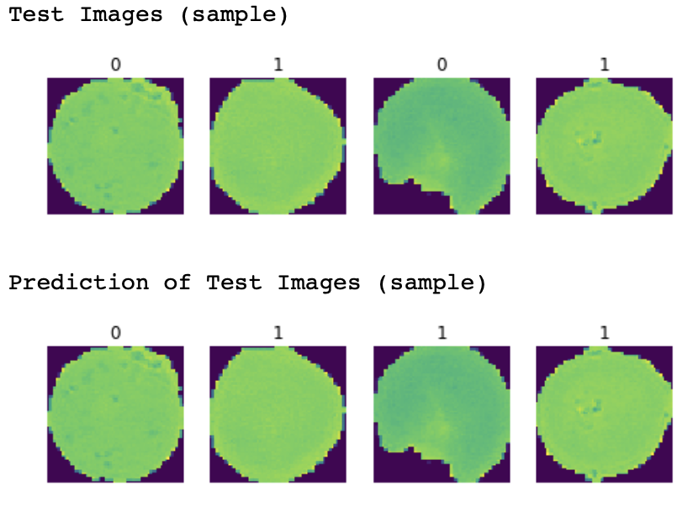
Sample Of Predictions From Model

Slide 16
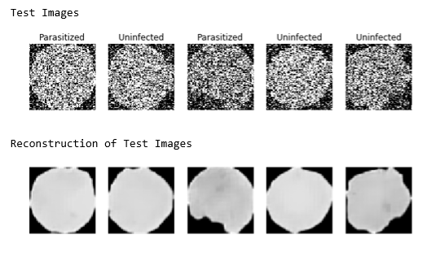
ADDITIONAL WORK AND FUTURE SCOPE
Attempted training a Convolutional autoencoder as an unsupervised learning problem
Architecture was 3 Conv-Pool encoding layers and 3 Conv-Upsampling decoding layers
Relu and Sigmoid Activation Functions
Mean squared error loss
RMS Prop

Slide 17
Acknowledgements
Prof. Jerome Braun, IE 7615, Northeastern University
Ramin Mohammadi, TA for IE 7615, Northeastern University
World malaria report 2017. Geneva: World Health Organization; 2017. Licence: CC BY-NC-SA 3.0 IGO.
D. Bibin et al.: Malaria Parasite Detection From Peripheral Blood Smear Images Using DBN
Luis Rosado et al. Automated Detection of Malaria Parasites on Thick Blood Smears via Mobile Devices
Najeed Ahmed Khan et al. Unsupervised identification of malaria parasites using computer vision
Rajaraman S, Antani SK, Poostchi M, Silamut K, Hossain MA, Maude RJ, Jaeger S, Thoma GR. 2018. Pre-trained convolutional neural networks as feature extractors toward improved malaria parasite detection in thin blood smear images. PeerJ 6:e4568 https://doi.org/10.7717/peerj.4568
Nicholas Sia et al. A Literature Review on Histogram Equalization and Its Variations for Digital Image Enhancement, 2013
Nitish Srivastava , Geoffrey Hinton , Alex Krizhevsky, Ilya Sutskever, Ruslan Salakhutdinov. Dropout: A Simple Way to Prevent Neural Networks from Overfitting.
https://towardsdatascience.com/hyper-parameters-in-action-part-ii-weight-initializers-35aee1a28404.

Slide 18
Questions ?
Thank You!

